Slide 1
Intro to SQL
January 5th 2019

Slide 2
Course Introduction

Slide 3
Introductions – About Me
Introduce yourself
Where you work or go to school
Your most favorite thing you’ve coded so far (or plan to code in the future!)
Why you want to learn about SQL Databases
Most recent picture you took with your phone

Slide 4
Objectives
Introduction to databases
Learn a bit about SQL
Start using SQL with MySQL in MySQL Workbench

Slide 5

First thing’s first
Download MySQL Workbench

Slide 6
Introduction to Databases

Slide 7
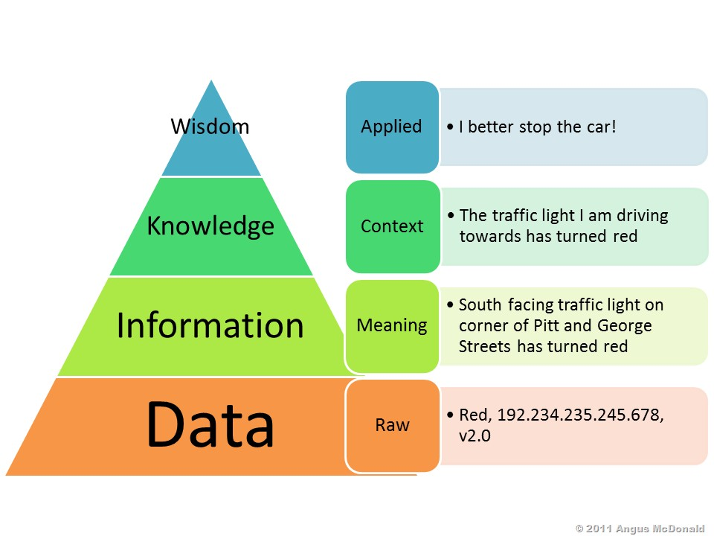
Data
Data = Raw Facts
Information = The result of processing data to reveal its meaning
Accurate, relevant, and timely information is the key to good decision making, and good decision making is the key to organizational survival in a global environment.

Slide 8
What is a database?
“A structured set of data held in a computer, especially one that is accessible in various ways.”
Persistency

Slide 9
Database Management Systems (DBMS)
Database Management Systems (DBMS) – Serves as the intermediary between the user and the database. (Ex. MySQL)
Data storage, retrieval, and updates
Transaction support
Concurrency control
Recovery services
Authorization services
Notes:
A DBMS Supports:
Data storage, retrieval, and updates
Transaction support (ensures that all the updates corresponding to a given transaction are made)
Concurrency Control Services (a mechanism to ensure that the database is updated correctly when multiple users are updating the database concurrently)
Recovery Services (recovers the database in the event that it is damaged in any way)
Authorization services (a mechanism to ensure that only authorized users can access the database)

Slide 10
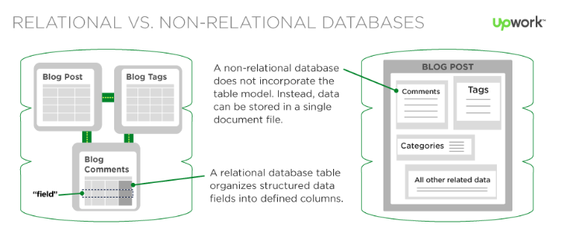
Relational vs. Non-Relational
Relational Database – A rigid, structured way of storing data, like a phone book.
Non-Relational Database – Allows for storage of any data type with no relationships between the data.
Notes:
Relational – More setup, more expensive, ideal for anything with relationships between the data, great for querying
Non-Relational (NoSQL) – Limited setup, generally pretty cheap, ideal for things that don’t have relationships (document storage, key-value storage), terrible for querying

Slide 11
Data Modeling – Relational Databases
For data in a relational database to be effective, it needs to be structured in an organized way.
Schema - Relationships between tables and field types.
Normalization – Best practices for designing a data model.

Slide 12
Relationships
Student
Contact Info
One-to-One
Mother
Children
One-to-Many
Many-to-Many
Students
Classes

Slide 13
Data Normalization
First Normal Form Normalization - Three-step procedure:
Step One: Eliminate Repeating Groups
Step Two: Identify the Primary Key
Step Three: Identify all Dependencies
If it has a singe-attribute primary key, it will automatically be 2NF. Otherwise:
Second Normal Form Normalization:
Step One: Make new tables to eliminate partial dependencies
Step Two: Reassign corresponding dependent attributes
Third Normal Form Normalization:
Step One: Make new tables to eliminate transitive dependencies
Step Two: Reassign corresponding dependent attributes
NORMAL FORM | CHARACTERISTIC
First normal form (1NF) | Table format, no repeating groups, and PK identified
Second normal form (2NF) | 1NF and no partial dependencies
Third normal form (3NF) | 2NF and no transitive dependencies
Notes:
First Normal Form Normalization - Three-step procedure:
Step One: Eliminate Repeating Groups
Step Two: Identify the Primary Key
Step Three: Identify all Dependencies
If it has a single-attribute primary key, it will automatically be 2NF. Otherwise:
Second Normal Form Normalization:
Step One: Make new tables to eliminate partial dependencies
Step Two: Reassign corresponding dependent attributes
Third Normal Form Normalization:
Step One: Make new tables to eliminate transitive dependencies
Step Two: Reassign corresponding dependent attributes

Slide 14
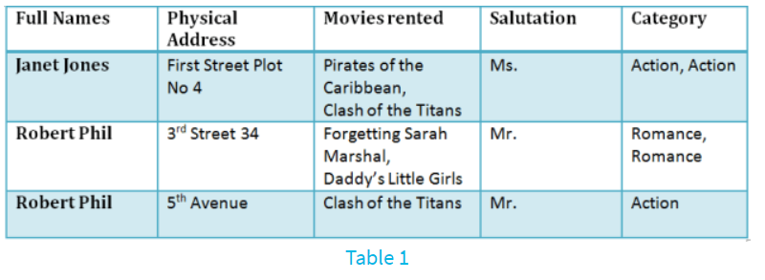
Data Normalization Example
Notes:
Movies rented and category have multiple values

Slide 15
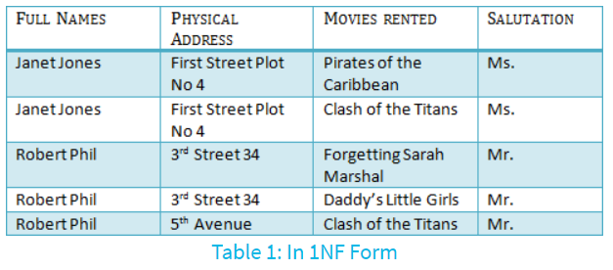
Data Normalization Example – 1st Normal Form
First Normal Form Rules:
Each table cell should hold a single value
Each record needs to be unique (primary key)
Notes:
What is a key?
A key is a value used to identify a record in a table uniquely.
What is a Composite Key?
A composite key is a primary key composed of multiple columns used to identify a record. Here we have a composite key with Full Name and Physical Address (although there is some things that are wrong with it already, because they are not unique).

Slide 16
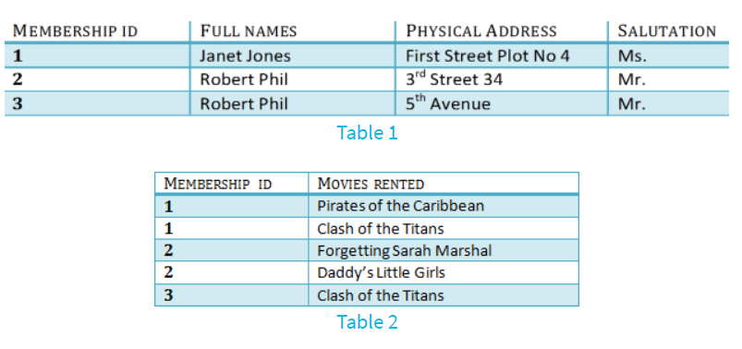
Data Normalization Example – 2nd Normal Form
Second Normal Form Rules:
Be in 1st NF
Single Column Primary Key
Notes:
Foreign Keys
Foreign keys reference the primary key of another table and helps to connect your tables!

Slide 17
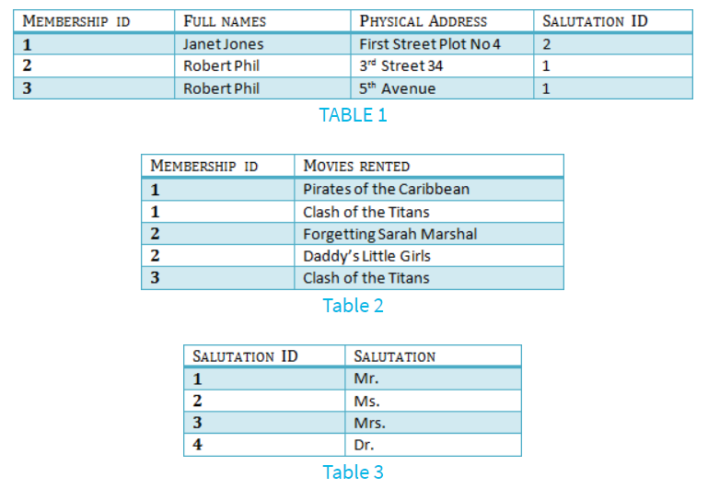
Data Normalization Example – 3rd Normal Form
Third Normal Form Rules:
Be in 2nd NF
Has no “transitive functional dependencies”
Notes:
Transitive Functional Dependency
When changing a non-key column might cause any of the other columns to change (ex. Changing the non-key column “Full Name” may change “Salutation”

Slide 18
Data Normalization Exercise
EmployeeId | SalesPerson | SalesOffice | OfficeNumber | Customer1 | Customer2 | Customer3
1003 | Mary Smith | Chicago | 312-555-1212 | Ford | GM
1004 | John Hunt | New York | 212-555-1212 | Dell | HP | Apple
1005 | Martin Hap | Chicago | 312-555-1212 | Boeing
Notes:
First Normal Form Normalization - Three-step procedure:
Step One: Eliminate Repeating Groups
Step Two: Identify the Primary Key
Step Three: Identify all Dependencies
If it has a single-attribute primary key, it will automatically be 2NF. Otherwise:
Second Normal Form Normalization:
Step One: Make new tables to eliminate partial dependencies
Step Two: Reassign corresponding dependent attributes
Third Normal Form Normalization:
Step One: Make new tables to eliminate transitive dependencies
Step Two: Reassign corresponding dependent attributes

Slide 19
But why SQL?
SQL is the standard language used for communicating with the large majority of relational databases

Slide 20
A Brief History of SQL

Slide 21
History of SQL
Initially developed at IBM in the early 1970s to manipulate and retrieve data stored in IBM’s original quasi-relational database management system, System R.
Relational Software Inc. introduced the first commercially available implementation of SQL in 1979.
In 1986, ANSI and ISO took over ad adopted the standard “Database Language SQL” language definition.
ANSI specifies the pronunciation as “ess queue ell”, however even the creator Donald Chamberlin pronounces the language as “sequel”.

Slide 22
Let’s Get Started!

Slide 23
CRUD!
Create
Read
Update
Delete/Destroy

Slide 24
CREATE – Create Table
CREATE TABLE table_name(
column1 datatype,
column2 datatype
);

Slide 25
CREATE – ADD DATA
INSERT INTO table_name (column1, column2)
VALUES (value1, value2)

Slide 26
READ - Selects
SELECT column1, column2, …
FROM table_name;
Bonus: WHERE

Slide 27
Update – UPDATE TABLE
ALTER TABLE table_name
ADD column_name datatype;
ALTER TABLE table_name
DROP COLUMN column_name;

Slide 28
Update – UPDATE DATA
UPDATE table_name
SET column1 = value1, column2 = value2
WHERE condition;

Slide 29
Delete/Destroy – DELETE DATA
DELETE FROM table_name WHERE condition;
DELETE FROM table_name;

Slide 30
Delete/Destroy – DELETE TABLE
DROP TABLE table_name;

Slide 31
Let’s try something more advanced…

Slide 32
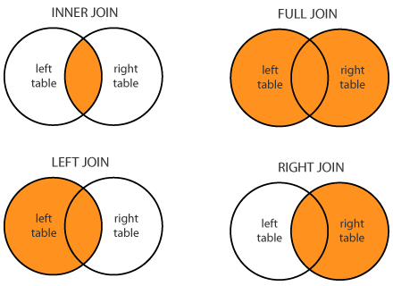
Joins – SQL’s Superpower
Join data from multiple tables to create a view of the data
SELECT Orders.OrderID, Customers.CustomerName, Orders.OrderDate FROM Orders INNER JOIN Customers
ON Orders.CustomerID=Customers.CustomerID;

Slide 33
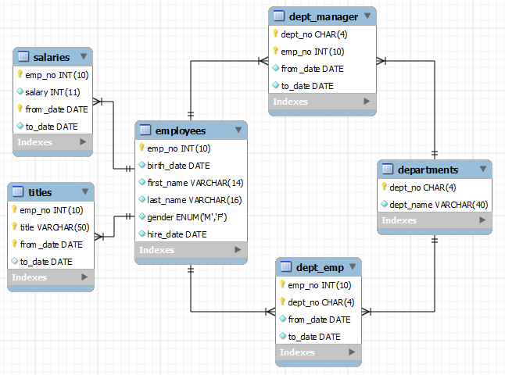
Employee Database
Downloaded from: http://www.ntu.edu.sg/home/ehchua/programming/sql/sampledatabases.html
Notes:
Notes from slides on: http://www.ntu.edu.sg/home/ehchua/programming/sql/sampledatabases.html
MySQL Reference: https://dev.mysql.com/doc/employee/en/
Download DB Link: https://github.com/datacharmer/test_db

Slide 34
Setup Employee Database
Open command prompt
Navigate to ‘test_db’ folder
mysql -u root -p employees < employees.sql
Validate import
mysql -u root -p -t < test_employees_sha.sql

Slide 35
Exercises
Find count of all Male and Female employees
Find average salary of department managers
Find average salary for each title
Find highest salary for each department

